Slide 1
Welcome
CS 472/572
Unsupervised Machine Learning
Clustering 1
Week-2 -Class -2
Spring 2026
Instructor: Dr. Khondker Fariha Hossain

Slide 2
𝑘-means Clustering
How to cluster categorical data?
Variant of 𝑘-means is used for clustering categorical data: 𝑘-modes Method
Replace mean of cluster with mode of data
A new dissimilarity measures to deal with categorical objects
A frequency-based method to update modes of clusters.

Slide 3
Distance/Similarity Measures for Categorical Data
Instead of Euclidean, you use measures suited for categories:
Hamming distance → counts mismatches between categorical attributes.
Jaccard similarity → for binary/categorical presence–absence features.
Matching coefficient → % of attributes that match.
Goodall’s measure or Gower’s similarity → handle mixed data types (numeric + categorical).
Once you compute a similarity or distance matrix, you can feed it into clustering algorithms like hierarchical clustering.

Slide 4
K-Modes Algorithm
Adaptation of K-Means for categorical data Designed to work where averaging (means) makes no sense.
Cluster centers = Modes Each cluster is represented by its mode (the most frequent category in each feature). Example: If most items in a cluster are "Red", "Circle", "Large", the cluster’s center is (Red, Circle, Large).
Distance measure Uses Hamming distance (counts the number of mismatched categories between a data point and the cluster mode).
Example: Comparing (Red, Circle, Large) vs (Blue, Circle, Small) → 2 mismatches.
Algorithm workflow
Randomly select k categorical points as initial modes.
Assign each data point to the closest mode (least mismatches).
Update cluster modes by taking the most frequent category in each attribute.
Repeat until assignments stabilize.

Slide 5
K-Modes Algorithm
Strengths
Handles large categorical datasets efficiently.
Results are interpretable (clusters described by actual categories).
Robust compared to forcing categorical data into numeric form.
2. Applications
Customer segmentation (demographics, preferences).
Market basket analysis.
Survey/medical records with categorical features

Slide 6
𝑘-Medoids Clustering
Picks actual objects to represent the clusters, using one representative object per cluster
Each remaining object is clustered with the representative object to which it is the most similar.
Partitioning method is then performed based on the principle of minimizing the sum of the dissimilarities between each object and its corresponding reference point
Absolute Error criterion is used
𝑘
𝐸 = ෍ ෍ 𝑑𝑖𝑠𝑡(𝑝, 𝑜_{𝑗})
𝑗=1 𝑝∈𝑐_{𝑗}
Where
Sum of absolute error
𝑝 is the point in space representing a given object in cluster 𝑐_{𝑗}
𝑂_{𝑗} is the representative object of
cluster 𝑐_{𝑗}

Slide 7
𝑘-Medoids Clustering
The iterative process of replacing representative objects by nonrepresentative objects continues as long as the quality of the resulting clustering is improved.
Quality is measured by a cost function that measures the average dissimilarity between an object and the representative object of its cluster.
Four cases are examined for each of the nonrepresentative objects, 𝑝.
Suppose, object 𝒑 is currently assigned to a cluster represented by medoid 𝑶_{𝒋}
𝑶_{𝒊}
𝑶_{𝒊}
𝑶_{𝒋}
𝒑
^{𝑶}𝒓𝒂𝒏𝒅𝒐𝒎
𝑶_{𝒊}
𝑶_{𝒊}
𝑶_{𝒋}
𝒑
^{𝑶}𝒓𝒂𝒏𝒅𝒐𝒎
𝒑
𝑶_{𝒋}
𝑶_{𝒋}
𝒑
^{𝑶}𝒓𝒂𝒏𝒅𝒐𝒎
^{𝑶}𝒓𝒂𝒏𝒅𝒐𝒎
Case 1 Before Swapping
Case 2
Case 3
Case 4
After Swapping

Slide 8
𝑘-Medoids Clustering
Each time a reassignment occurs, a difference in absolute error, 𝐸, is contributed to the cost function.
Therefore, the cost function calculates the difference in absolute-error value if a current representative object is replaced by a nonrepresentative object.
The total cost of swapping is the sum of costs incurred by all nonrepresentative objects.
If the total cost is negative, then 𝑂_{𝑗} is replaced or swapped with 𝑂_{𝑟𝑎𝑛𝑑𝑜𝑚}
If the total cost is positive, the current representative object, 𝑂_{𝑗}, is considered acceptable, and
nothing is changed.
PAM(Partitioning Around Medoids) was one of the first k-medoids algorithms

Slide 9
𝑘-Medoids Clustering
Input: 𝑘 number of clusters, 𝑛 data objects from data set 𝐷
Output: a set of 𝑘 clusters Algorithm:
Arbitrarily select 𝑘 objects as the representative objects or seeds
Repeat
Assign each remaining objects to the cluster with the nearest representative object
Randomly select the non- representative object 𝑂_{𝑟𝑎𝑛𝑑𝑜𝑚}
Compute the total cost 𝑆 of swapping 𝑂_{𝑗} with 𝑂_{𝑟𝑎𝑛𝑑𝑜𝑚}
If 𝑆 < 0, then swap 𝑂_{𝑗} with 𝑂_{𝑟𝑎𝑛𝑑𝑜𝑚} to form the new set of 𝑘 representative objects
Until no change

Slide 10
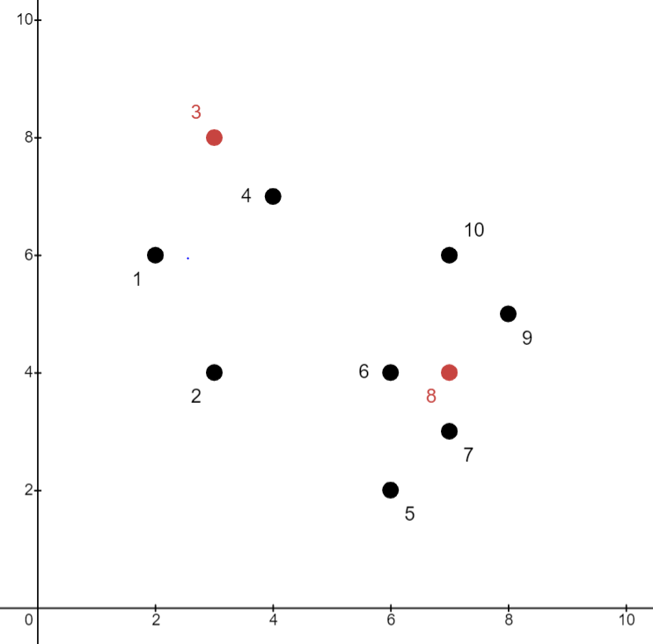
𝑘-Medoids Clustering
Data Objects
Aim: Create two Clusters
Step 1:
Choose randomly two medoids
(representative objects)
𝑂₃ = 3,8
𝑂₈ = (7,4)
 | X | Y
O1 | 2 | 6
O2 | 3 | 4
O3 | 3 | 8
O4 | 4 | 7
O5 | 6 | 2
O6 | 6 | 4
O7 | 7 | 3
O8 | 7 | 4
O9 | 8 | 5
O10 | 7 | 6

Slide 11
𝑘-Medoids Clustering
Data Objects
Aim: Create two Clusters
Step 2:
Assign each object to the closest representative object
Using Euclidean distance, we form following clusters
 | X | Y | Cluster
O1 | 2 | 6
O2 | 3 | 4
O3 | 3 | 8
O4 | 4 | 7
O5 | 6 | 2
O6 | 6 | 4
O7 | 7 | 3
O8 | 7 | 4
O9 | 8 | 5
O10 | 7 | 6

Slide 12
𝑘-Medoids Clustering
Data Objects
Aim: Create two Clusters
Step 2:
Assign each object to the closest
representative object
Using Euclidean distance, we form following clusters
C1={O1, O2, O3, O4}
C2={O5, O6, O7, O8, O9, O10}
 | X | Y | Cluster
O1 | 2 | 6 | C1
O2 | 3 | 4 | C1
O3 | 3 | 8 | C1
O4 | 4 | 7 | C1
O5 | 6 | 2 | C2
O6 | 6 | 4 | C2
O7 | 7 | 3 | C2
O8 | 7 | 4 | C2
O9 | 8 | 5 | C2
O10 | 7 | 6 | C2

Slide 13
𝑘-Medoids Clustering
Data Objects
Aim: Create two Clusters
Step 3:
Compute the absolute error (for the set of representative objects 𝑂₃ and 𝑂₈)
𝑘
𝐸 = ෍ ෍ 𝑝 − 𝑂_{𝑗}
𝑗=1 𝑝∈𝑐_{𝑗}
 | X | Y | Cluster
O1 | 2 | 6 | C1
O2 | 3 | 4 | C1
O3 | 3 | 8 | C1
O4 | 4 | 7 | C1
O5 | 6 | 2 | C2
O6 | 6 | 4 | C2
O7 | 7 | 3 | C2
O8 | 7 | 4 | C2
O9 | 8 | 5 | C2
O10 | 7 | 6 | C2
𝑬 = 𝑶_{𝟏} − 𝑶_{𝟑} + 𝑶_{𝟐} − 𝑶_{𝟑}
+ 𝑶_{𝟑} − 𝑶_{𝟑} + 𝑶_{𝟒} − 𝑶_{𝟑}
+ 𝑶_{𝟓} − 𝑶_{𝟖} + 𝑶_{𝟔} − 𝑶_{𝟖} + 𝑶_{𝟕} − 𝑶_{𝟖} + 𝑶_{𝟖} − 𝑶_{𝟖} + 𝑶_{𝟗} − 𝑶_{𝟖} + 𝑶_{𝟏𝟎} − 𝑶_{𝟖}
𝑶_{𝟏} − 𝑶_{𝟑} = 𝒙_{𝟏} − 𝒙_{𝟑} + 𝒚_{𝟏} − 𝒚_{𝟑}
. . . . Manhattan Distance

Slide 14
𝑘-Medoids Clustering
Data Objects
Aim: Create two Clusters
Step 3:
Compute the absolute error (for the set of representative objects 𝑂₃ and 𝑂₈)
𝑘
𝐸 = ෍ ෍ 𝑝 − 𝑂_{𝑗}
𝑗=1 𝑝∈𝑐_{𝑗}
 | X | Y | Cluster
O1 | 2 | 6 | C1
O2 | 3 | 4 | C1
O3 | 3 | 8 | C1
O4 | 4 | 7 | C1
O5 | 6 | 2 | C2
O6 | 6 | 4 | C2
O7 | 7 | 3 | C2
O8 | 7 | 4 | C2
O9 | 8 | 5 | C2
O10 | 7 | 6 | C2
𝑬 = 𝑶_{𝟏} − 𝑶_{𝟑} + 𝑶_{𝟐} − 𝑶_{𝟑}
+ 𝑶_{𝟑} − 𝑶_{𝟑} + 𝑶_{𝟒} − 𝑶_{𝟑}
+ 𝑶_{𝟓} − 𝑶_{𝟖} + 𝑶_{𝟔} − 𝑶_{𝟖} + 𝑶_{𝟕} − 𝑶_{𝟖} + 𝑶_{𝟖} − 𝑶_{𝟖} + 𝑶_{𝟗} − 𝑶_{𝟖} + 𝑶_{𝟏𝟎} − 𝑶_{𝟖}
𝑬 = 𝟑 + 𝟒 + 𝟎 + 𝟐 + 𝟑 + 𝟏 + 𝟏 + 𝟎 + 𝟐 + 𝟐
𝑬 = 𝟏𝟖

Slide 15
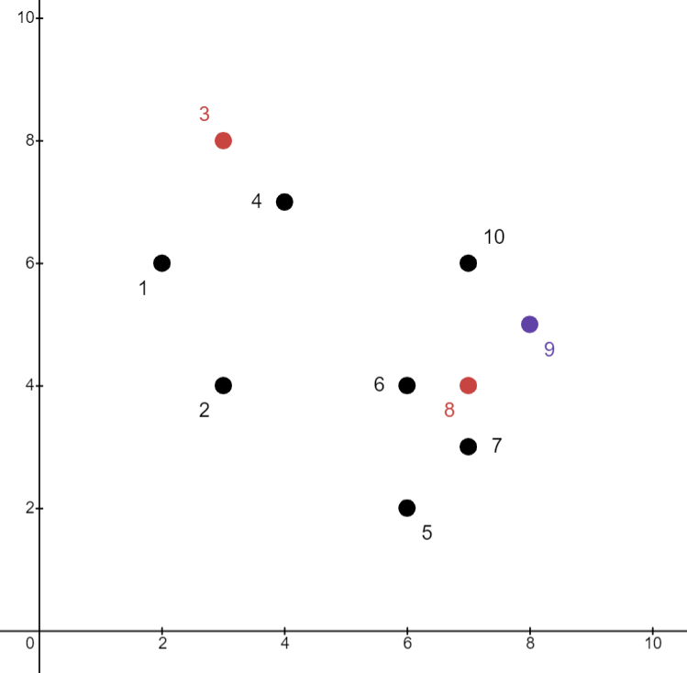
𝑘-Medoids Clustering
Data Objects
Aim: Create two Clusters
Step 4:
Choose a random object 𝑂₉
Swap 𝑂₈ and 𝑂₉
Compute the absolute error (for the set of representative objects
𝑂₃ and 𝑂₉)
 | X | Y | Cluster
O1 | 2 | 6 | C1
O2 | 3 | 4 | C1
O3 | 3 | 8 | C1
O4 | 4 | 7 | C1
O5 | 6 | 2 | C2
O6 | 6 | 4 | C2
O7 | 7 | 3 | C2
O8 | 7 | 4 | C2
O9 | 8 | 5 | C2
O10 | 7 | 6 | C2

Slide 16
𝑘-Medoids Clustering
Data Objects
Aim: Create two Clusters
 | X | Y | Cluster
O1 | 2 | 6 | C1
O2 | 3 | 4 | C1
O3 | 3 | 8 | C1
O4 | 4 | 7 | C1
O5 | 6 | 2 | C2
O6 | 6 | 4 | C2
O7 | 7 | 3 | C2
O8 | 7 | 4 | C2
O9 | 8 | 5 | C2
O10 | 7 | 6 | C2
𝑬 = 𝑶
𝟏
− 𝑶
𝟑
+ 𝑶 − 𝑶 + 𝑶 − 𝑶 + 𝑶 − 𝑶
𝟐 𝟑 𝟑 𝟑 𝟒
𝟑
+ 𝑶_{𝟗} − 𝑶_{𝟗} + 𝑶_{𝟏𝟎} − 𝑶_{𝟗}
+ 𝑶_{𝟓} − 𝑶_{𝟗} + 𝑶_{𝟔} − 𝑶_{𝟗} + 𝑶_{𝟕} − 𝑶_{𝟗} + 𝑶_{𝟖} − 𝑶_{𝟗}
𝑬 = 𝟑 + 𝟒 + 𝟎 + 𝟐 + (𝟓 + 𝟑 + 𝟑 + 𝟐 + 𝟎 + 𝟐)
𝑬 = 𝟐𝟒
Step 5:
Compute the cost function
𝑆 = 𝐴𝑏𝑠𝑜𝑙𝑢𝑡𝑒 𝐸𝑟𝑟𝑜𝑟 𝑓𝑜𝑟𝑶 , 𝑶
− 𝐴𝑏𝑠𝑜𝑙𝑢𝑡𝑒 𝐸𝑟𝑟𝑜𝑟 𝑓𝑜𝑟𝑶 , 𝑶
𝟑 𝟖
𝟑 𝟗
𝑆 = 18 − 24 = −6
As 𝑆 < 0, we swap 𝑶_{𝟖} with 𝑶_{𝟗}

Slide 17
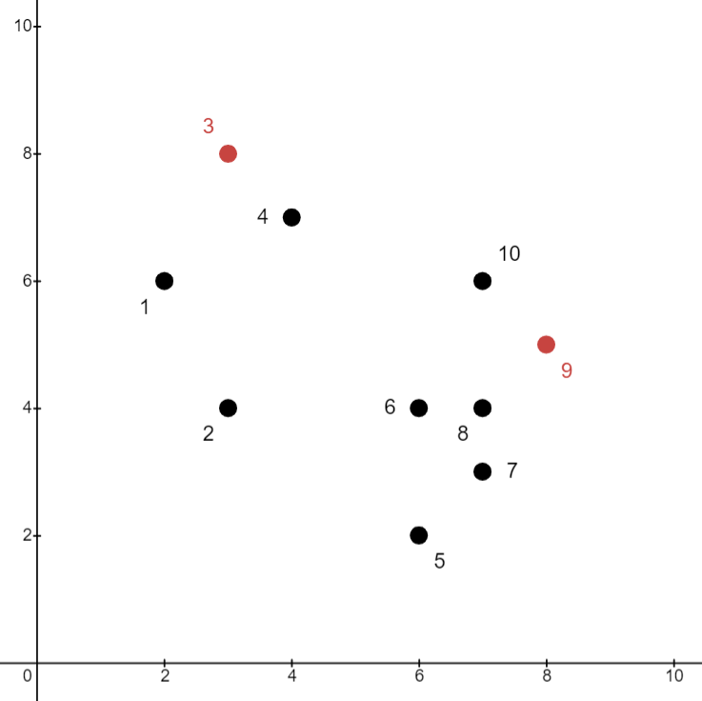
𝑘-Medoids Clustering
Data Objects
Aim: Create two Clusters
Step 6:
New medoids are 𝑶_{𝟑} with 𝑶_{𝟗}
Repeat Step 2
Assign each object to the closest representative object.
 | X | Y | Cluster
O1 | 2 | 6 | C1
O2 | 3 | 4 | C1
O3 | 3 | 8 | C1
O4 | 4 | 7 | C1
O5 | 6 | 2 | C2
O6 | 6 | 4 | C2
O7 | 7 | 3 | C2
O8 | 7 | 4 | C2
O9 | 8 | 5 | C2
O10 | 7 | 6 | C2
X
Y
Cluster
O1
2
6
O2
3
4
O3
3
8
O4
4
7
O5
6
2
O6
6
4
O7
7
3
O8
7
4
O9
8
5
O10
7
6

Slide 18
𝑘-Medoids Clustering
Which method is more robust 𝑘-Means or 𝑘-Medoids?
The k-medoids method is more robust than k-means in the presence of noise and outliers, because a medoid is less influenced by outliers or other extreme values than a mean.
The processing of 𝑘-Medoids is more costly than the k-means method.

Slide 19
Properties of K-­‐means algorithm
Guaranteed to converge in a finite number of iterations
Running time per iteration:
Assign data points to closest cluster center
O(KN) time
Change the cluster center to the average of its assigned points
O(N)

Slide 20

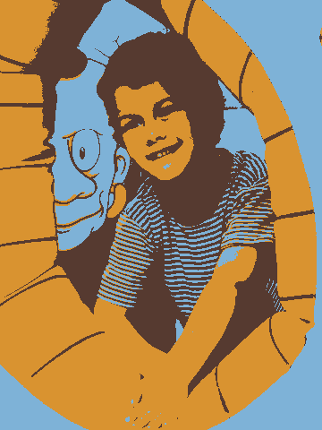

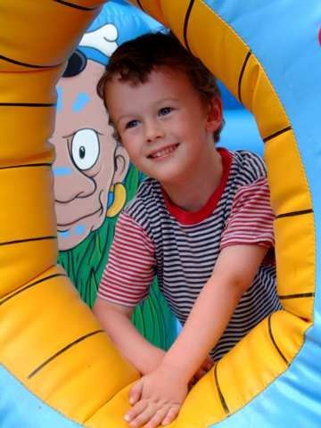

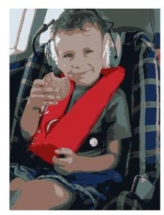
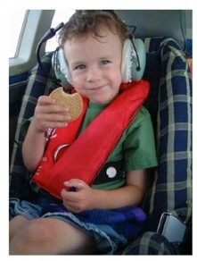
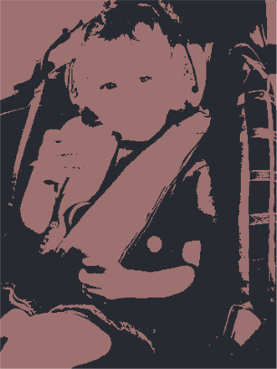
Example: K-Means for Segmentation
K=2
Original
K = 2
Goal of Segmentation is
K = 3 K = 10
Original image
to partition an image into regions each of which has reasonably homogenous visual appearance.

Slide 21
Example: K-Means for Segmentation
K=2
K=3
K=10
Original
K = 2
K = 3
K = 10
Original image

Slide 22
Example: K-Means for Segmentation
K=2
K=3
K=10
Original
K = 2
K = 3
K = 10
Original image
4%
8%
17%

Slide 23
𝑘-means Vs K-medoids Vs K-modes
Aspect | K-means | K-medoids | K-modes
Data type | Numeric/continuous features | Any type for which a distance is defined (numeric, categorical, string, edit distance, etc.) | Categorical features (discrete labels)
Cluster “center” | Centroid = mean of points (not necessarily a real data point) | Medoid = actual data point minimizing total distance to others | Mode = most frequent category per feature (component-wise)
Dissimilarity | Typically Euclidean (squared distance) | Arbitrary distance (Euclidean, Manhattan, DTW, edit distance…) | Matching/Hamming dissimilarity (0 if equal, 1 if not)
Objective | Minimize sum of squared distances (intra-cluster variance) | Minimize sum of distances to medoids | Minimize sum of mismatches to modes
Outliers | Sensitive (means get pulled) | Robust(er) (medoid is a real point, less pulled) | Robust to numeric outliers (not used); can be sensitive to rare categories
Shape assumption | Works best for spherical, similarly sized clusters after scaling | More flexible (depends on chosen distance) | Categorical analog of k-means; no geometric shape assumption
Per-iteration cost (rough) | O(n·k·d) + updates | Higher than k-means; PAM ~ O(k·(n−k)²) (CLARA/CLARANS are faster approximations) | O(n·k·p) (p = #categorical features)
Initialization | Often k-means++ | Medoid heuristics or k-means++-style on distances | Random modes or k-modes++
Common variants | Mini-batch k-means, kernel k-means | PAM, CLARA, CLARANS | k-modes with frequency weights; k-prototypes (for mixed data)

Slide 24
When to use which!!!
Use K-means when features are numeric, scaled, and you expect roughly compact (spherical) clusters. Fast and simple; watch out for outliers and scaling.
Use K-medoids when you want robustness or need a custom distance (e.g., Manhattan, DTW for time series, edit distance for strings) and/or you want a representative example as the center.
Use K-modes when features are purely categorical (e.g., color = {red, blue}, brand = {A,B,…}). For mixed numeric + categorical, use k-prototypes (modes for categorical + means for numeric).
Practical tips
Always standardize/normalize numeric features before K-means/K-medoids (if using numeric distances).
Try several k and seeds; evaluate with internal indices (e.g., silhouette) and stability checks.
For large n with K-medoids, prefer CLARA/CLARANS (sampling/heuristic) to keep runtime manageable.

Slide 25
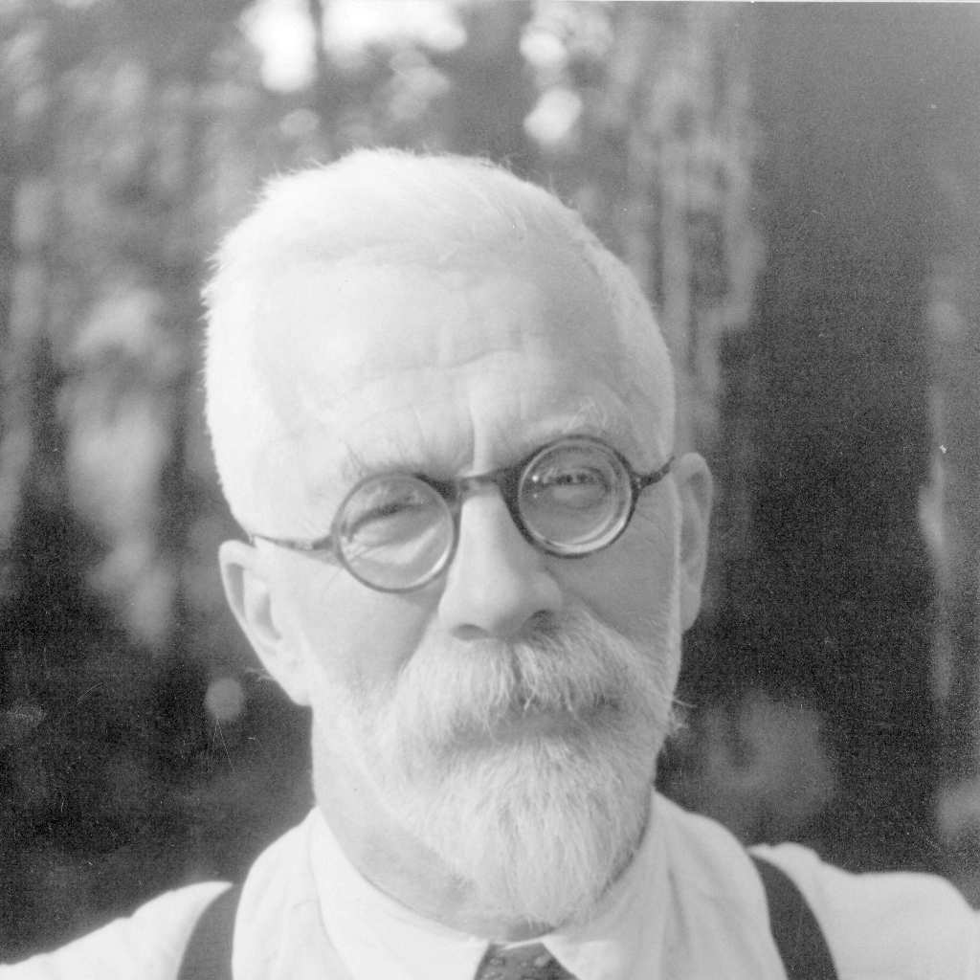
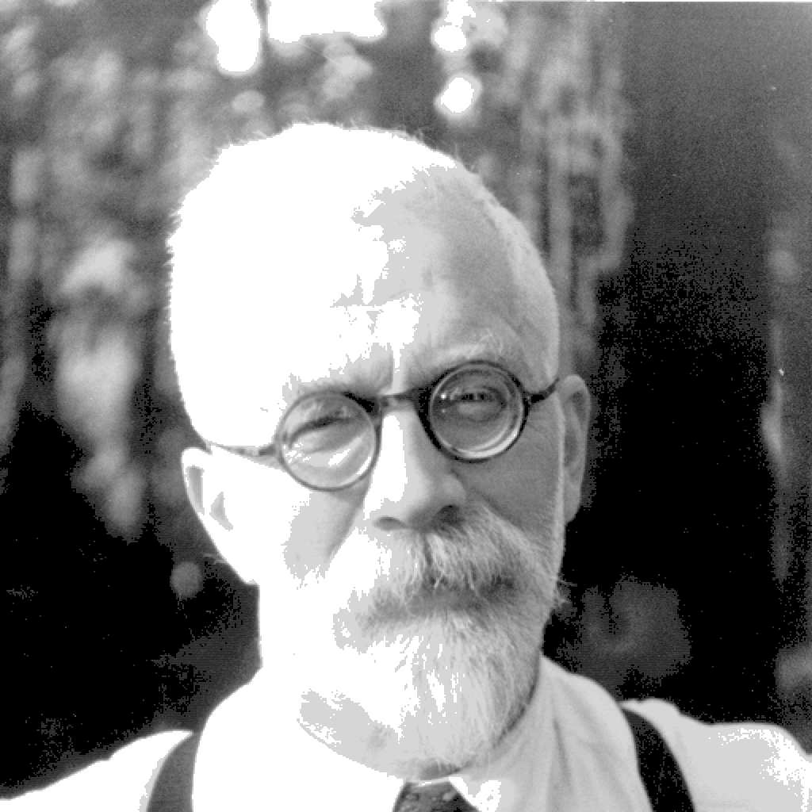
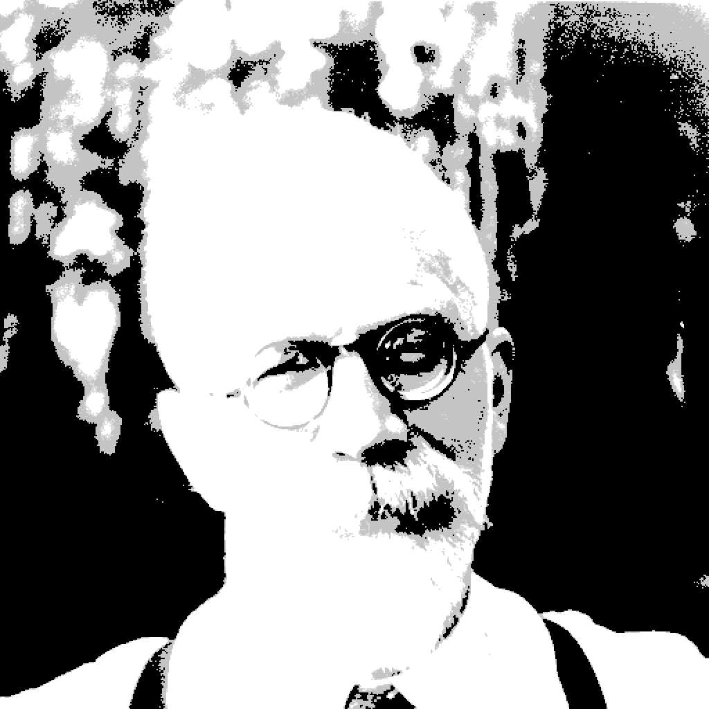
Example: Vector quantization
FIGURE 14.9. Sir Ronald A. Fisher (1890 − 1962) was one of the founders of modern day statistics, to whom we owe maximum-likelihood, sufficiency, and many other fundamental concepts. The image on the left is a 1024×1024 grayscale image at 8 bits per pixel. The center image is the result of 2 × 2 block VQ, using 200 code vectors, with a compression rate of 1.9 bits/pixel. The right image uses only four code vectors, with a compression rate of 0.50 bits/pixel
[Figure from Hastie et al. book]

Slide 26
What is Vector Quantization?
Vector Quantization = Clustering for compression
Technique that maps a large set of vectors into a smaller set of representative vectors
These representative vectors are called codebook vectors (or prototypes)
Purpose: reduce data complexity and storage while preserving structure
Widely used in compression, clustering, and pattern recognition

Slide 27
How It Works
1. Training phase: Cluster data (e.g., with K-Means) to create codebook vectors
2. Encoding: Replace each data point with nearest code vector’s index
3. Decoding: Reconstruct data by replacing index with its code vector
4.Compact representation with some information loss
- VQ is essentially K-Means clustering repurposed for compression
- Cluster centers = codebook vectors
- Each data vector is quantized to nearest codebook vector

Slide 28
Application
Imagine millions of 2D points
Instead of storing all, cluster into 100 regions
Each region is represented by its centroid (a code vector)
Store 100 centroids + assignments instead of all points
- Image compression (reduce pixel values into representative colors)
- Speech coding (audio frames represented with codebook sounds)
- Pattern recognition (simplify feature spaces)
- Neural networks (product quantization in ANN search)

Slide 29
On Class EXERCISE
Link: https://colab.research.google.com/drive/1o-NvOvMF10W6u3FNGegx-dUKeXmYr3sg?usp=sharing

Slide 30
Thank You
Reference:
Credits: Dr.R.R.Rajalaxmi Professor/CSE Kongu Engineering College Perundurai Ms. Rashmi Bhat, Assistant prof, Slideshare
David Sontag New York University Dr. T. Veeramakali,Assoc. Prof. / DSBS, SRM Institute of Science & Technology Kattankulathur, Chennai-603203.
.

